Slide 1

Tech Careers : ML Engineer vs SEO Specialist
Exploring two diverse tech careers : coding-intensive and non-coding roles.
Farjan Ahmmed
ID : 232-35-738

Slide 2

Machine Learning Engineer : Role Overview
1
Definition
Designs, implements and deploys ML models.
2
Responsibility
Creates AI-driven solutions for various industries.
3
Impact
Drives innovation in AI and data science fields.

Slide 3





ML Engineer : Job Fields
Robotics
Developing intelligent automated systems.
Artificial Intelligence
Creating smart algorithms for various applications.
Computer Vision
Enabling machines to interpret visual information.
Natural Language Processing
Improving human-computer communication through language understanding.

Slide 4

ML Engineer
Salary
Level
Bangladesh (BDT/month)
Global (USD/year)
Entry
50,000 - 100,000
70,000 - 100,000
Mid
100,000 - 200,000
100,000 - 140,000
Senior
200,000+
150,000 - 200,000+

Slide 5




ML Engineer : Future Prospects
Growing Demand
Increasing need for AI-driven solutions globally.
Job Growth
Significant expansion due to AI advancements.
Impact Areas
Automation, predictive analytics and healthcare innovations.

Slide 6


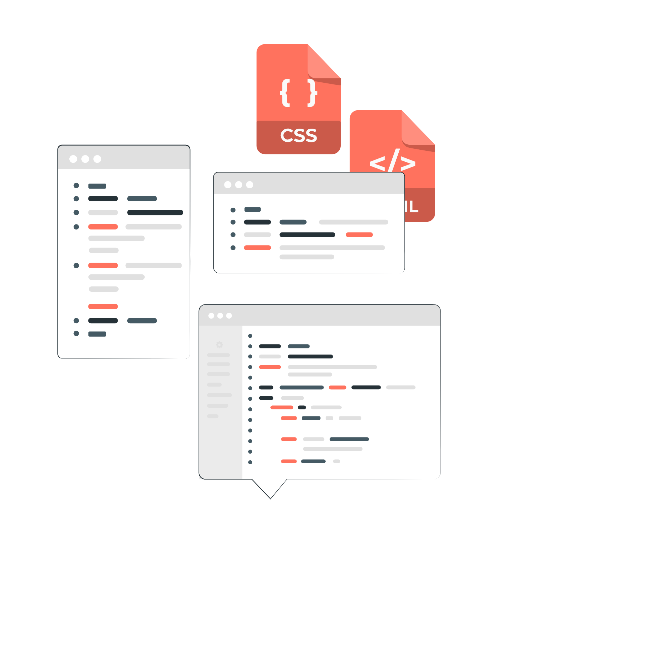
ML Engineer : Required Skills
Technical Skills
Tools & Libraries
Education
Programming, Data Structures, Algorithms, Statistics,
Machine Learning
TensorFlow, PyTorch, Scikit-Learn, Keras
Degree in Computer Science, Mathematics, Statistics
or related

Slide 7

SEO Specialist : Role Overview
1
Definition
Optimizes websites for improved search
engine rankings.
2
Responsibility
Drives organic traffic to websites.
3
Impact
Enhances online visibility for businesses.

Slide 8





SEO Specialist : Job Fields
Digital Marketing
Promoting brands through online channels.
Content Marketing
Creating and optimizing content for search engines.
E-commerce
Improving online store visibility and sales.
Media & Publications
Enhancing online presence for news and content sites.

Slide 9

SEO
Specialist
Salary
Level
Bangladesh (BDT/month)
Global (USD/year)
Entry
30,000 - 50,000
35,000 - 50,000
Mid
50,000 - 100,000
50,000 - 70,000
Senior
100,000+
70,000 - 100,000+

Slide 10

SEO Specialist : Required Skills
Technical Skills
Search engine algorithms, keyword research, content optimization
Tools
Google Analytics, Search Console, SEMrush, Ahrefs, Moz
Education
No specific degree; background in Marketing beneficial

Slide 11

SEO Specialist : Future Prospects
Voice Search optimization
Adapting SEO for voice search and mobile optimization.
AI-Driven SEO
Leveraging AI for data analysis and trend prediction
Multichannel SEO Expertise
Expanding SEO to social, video and e-commerce platforms.

Slide 12

Thank You

